Slide 1
Dialog state tracking challenge(DSTC)
2016-11-16

Slide 2
DEFINITION
A dialog state s_{t}
a data structure drawn from a set S that summarizes the dialog history up to time t to a level of detail that provides sufficient information for choosing the next system action.
_{第t轮对话及其历史对话的信息表示}
A dialog state tracker
根据历史对话状态，确定当前的对话状态

Slide 3
DSTC Series
DSTC 1,2 & 3
data: route, restaurant, tourist
DSTC 1: fill slots
DSTC 2: include user goal changes
DSTC 3: new slots not in train data
Example:
The Dialog State Tracking Challenge Series.pdf P25

Slide 4
DSTC Series
DSTC 4
dialog state tracking on human-human dialogs
DSTC 5
As DSTC 4
Cross language

Slide 5
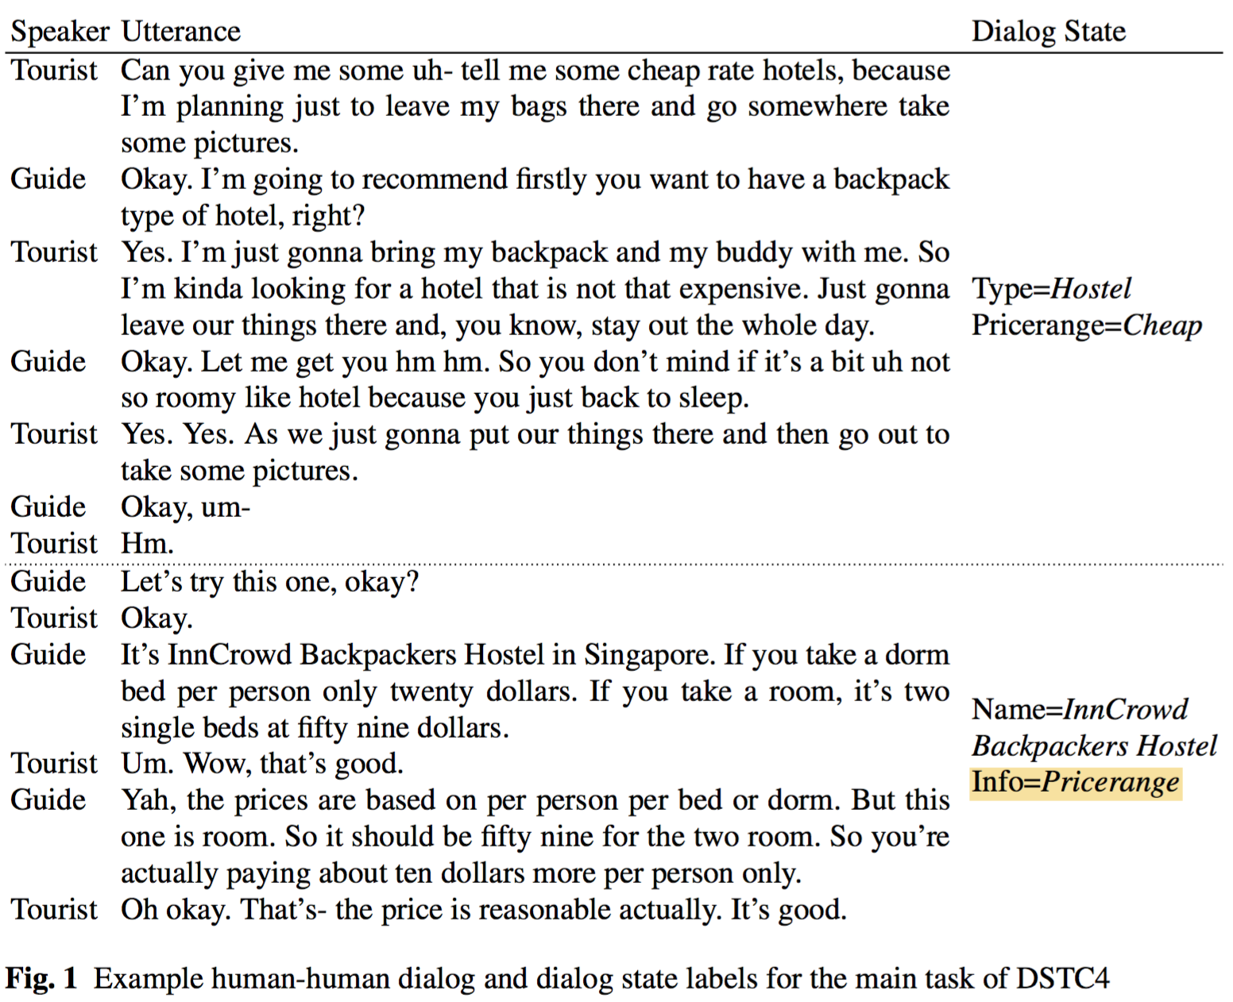

Slide 6
Main method
Hand-crafted rules
Generative models
Discriminative models

Slide 7
Hand-crafted rules
MIT JUPITER weather information system
maintained a set of state variables which were updated using hand-written rules in a dialog control table (Zue et al., 2000)

Slide 8
Hand-crafted rules
the Information State Update approach
use hand-written update rules to track a rich data structure called an “information state” (Larsson and Traum, 2000).

Slide 9
Hand-crafted rules
Good:
A benefit for bootstrapping
an accessible way for developers to incorporate domain knowledge
Bad:
an inability to make use of the entire ASR or SLU N-Best list

Slide 10
Hand-crafted rules
Change:
more recent dialog state trackers based on hand-crafted rules compute scores for all dialog states suggested by the whole ASR/SLU N-best list (Wang and Lemon, 2013; Sun et al., 2014a).
These methods use hand-designed formulas to compute a posterior b(s) of a dialog state s given ASR/SLU confidence scores and previous estimates of b(s), and thus can overcome some SLU errors.

Slide 11
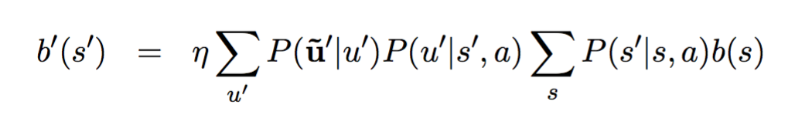
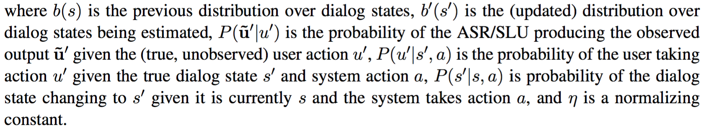
Generative models
a Bayesian network
that relates the dialog state s to the system action a, the (true, unobserved) user action u, and ASR or SLU result u ̃.

Slide 12
Generative models
Early approaches
enumerated all possible dialog states, then used variants of Eq. 1 to score them
(Roy et al., 2000; Zhang et al., 2001; Heckerman and Horwitz, 1998; Horvitz and Paek, 1999; Meng et al., 2003; Williams et al., 2005).

Slide 13
Generative models
Bad:
the number of states s can be enormous.
Good:
In end-to-end evaluations, generative approaches have been shown to yield better dialog perfor- mance than hand-crafted rules (Young et al., 2010; Thomson and Young, 2010).

Slide 14
Generative models
Limit:
make independence assumptions which are invalid
important features of dialog history have to be ignored（violation of the Markov assumption ）
cannot easily incorporate large sets of potentially informative features from the ASR, SLU, dialog history (all dependencies between features must be explicitly modeled, which requires an impractical amount of data. )

Slide 15
Generative models
For example, it is often assumed that errors are generated from a uniform distribution, when in fact they are highly correlated: “twenty” is much more often mis-recognized as “seventy” than as “downtown pittsburgh” (Williams, 2012c)

Slide 16
Discriminative models
Good：
incorporate a large number of features, and can be optimized directly for prediction accuracy.

Slide 17
Discriminative models
discriminative approaches
compute scores for dialog states with discriminatively trained conditional models of the form b′(s′) = P(s′|f′)
where f ′ are features extracted from the ASR, SLU, and dialog history.

Slide 18
Discriminative models
learn a simple classifier.
Bohus and Rudnicky (2006).
Metallinou et al. (2013) alter the logistic regression model so that it learns a single weight for each feature.
Williams (2014) applies a ranking algorithm which has the ability to construct conjunctions of features.
Henderson et al. (2013) applies a deep neural network as a classifier.

Slide 19
Discriminative models
a sequential process.
a discriminative Markov Model can be applied, where the distribution from the previous turn’s prediction can be used as a feature (Ren et al., 2014b,a).
dialog can be cast as a conditional random field (CRF) (Lafferty et al., 2001), in which features are associated with each dialog turn, and CRF decoding determines the most likely final dialog state conditioned on the entire sequence (Lee and Eskenazi, 2013; Ren et al., 2013; Kim and Banchs, 2014; Ma and Fosler-Lussier, 2014c).
recurrent neural networks can be estimated where the inputs are the observed ASR/SLU results, and the output is a distribution over dialog states (Henderson et al., 2014d).

Slide 20
Discriminative models
Henderson et al. (2014d) is also notable for operating directly on ASR output, without an SLU
first, it removes the need for feature design, and the risk of omitting an important feature, which can degrade performance unexpectedly (Williams, 2014).
Second, it avoids the work of building a separate SLU model.

Slide 21
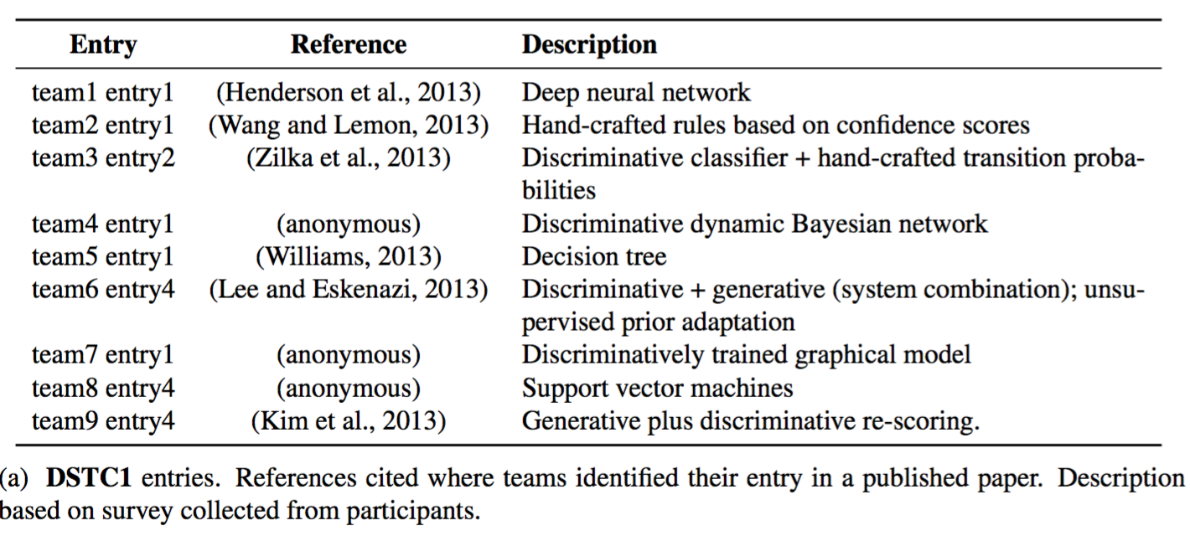
RESULT

Slide 22
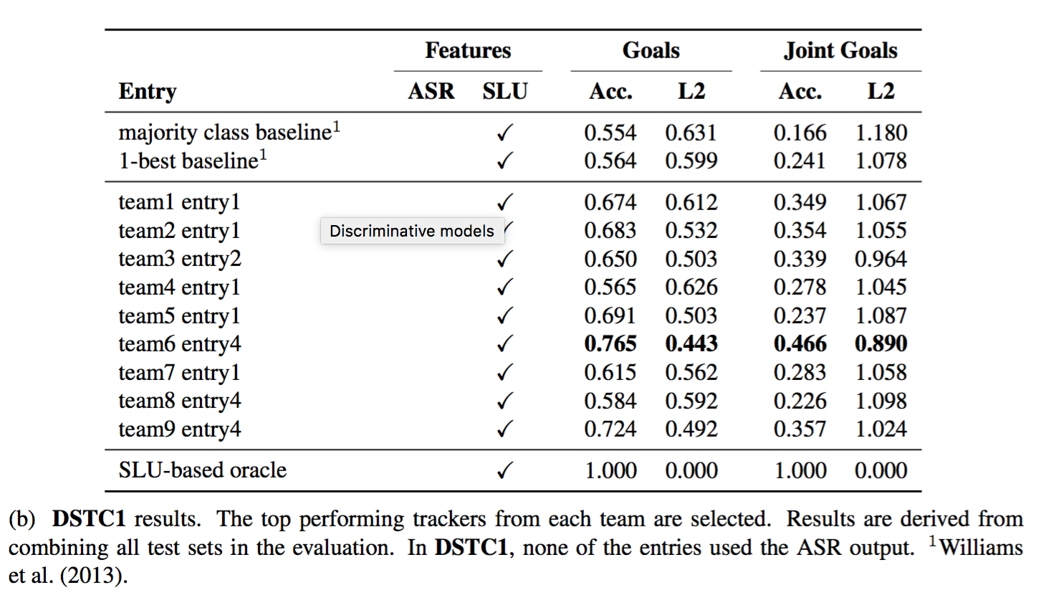
RESULT

Slide 23
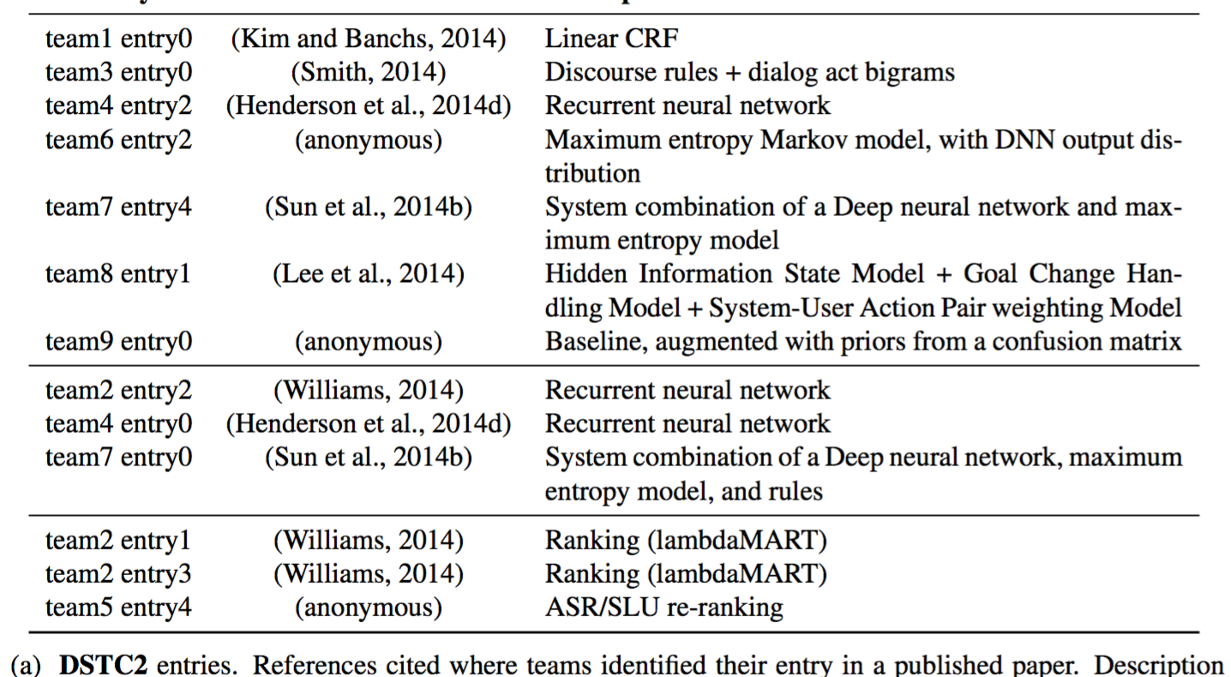
RESULT

Slide 24
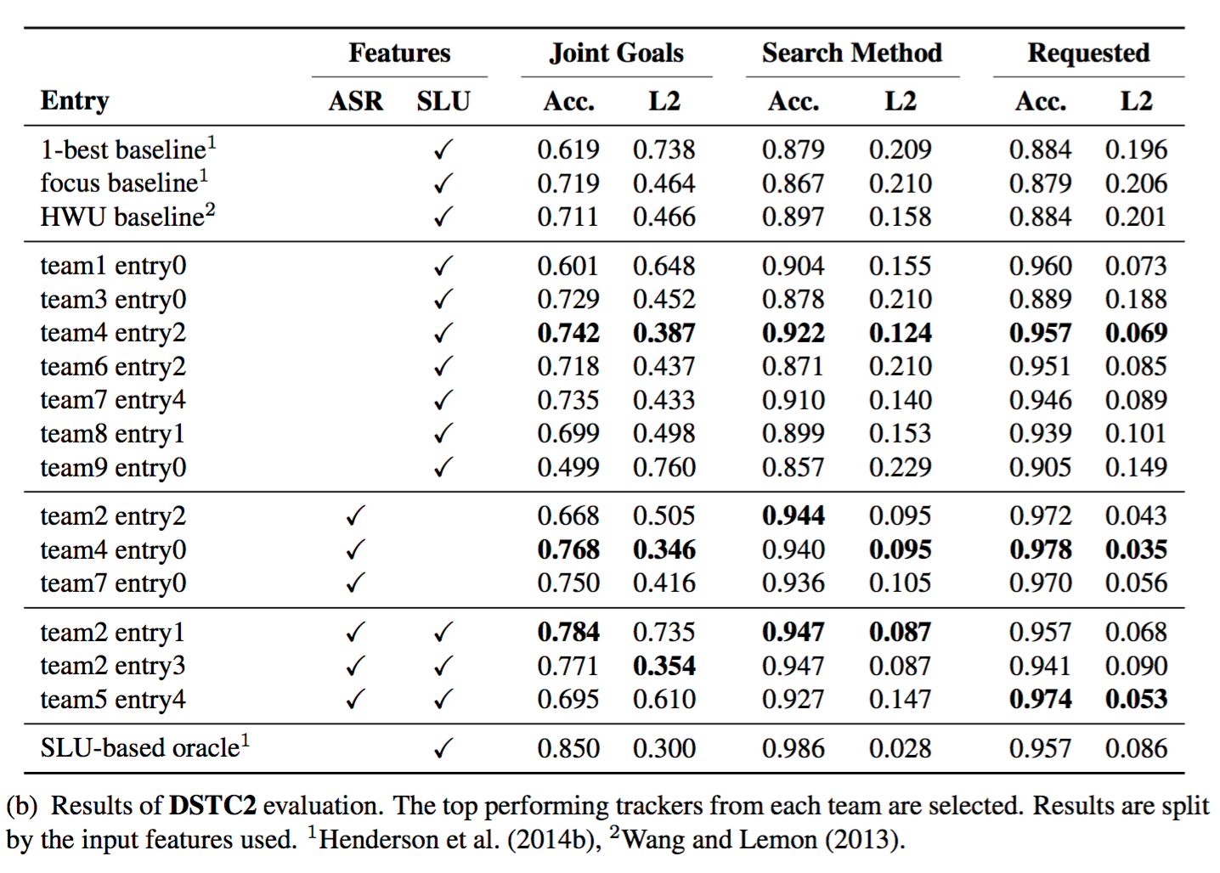
RESULT

Slide 25
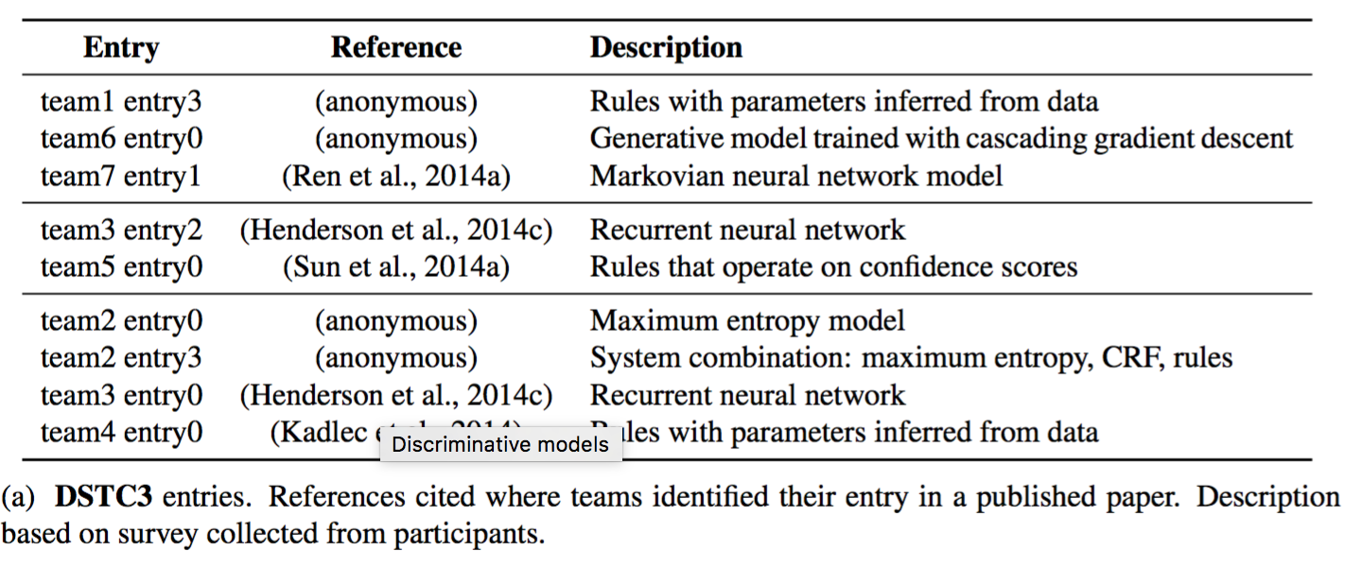
RESULT

Slide 26
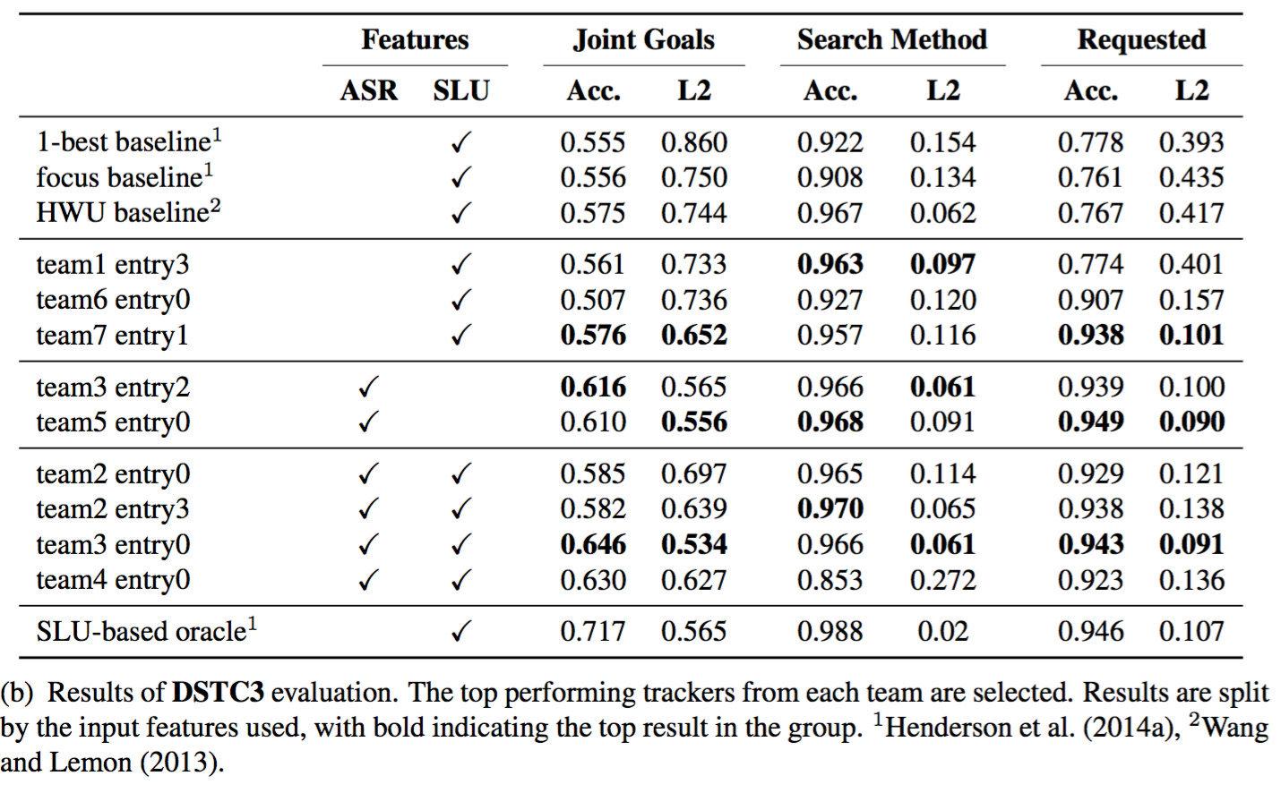
RESULT

Slide 27
YARBUS
Rule-based
不经过训练，只是从train-set中总结规则

Slide 28
YARBUS
Input：machine_acts, slu_hyps
Slu_hyps: (s,v), user_acts, score
Output: goal, method, request_slot

Slide 29
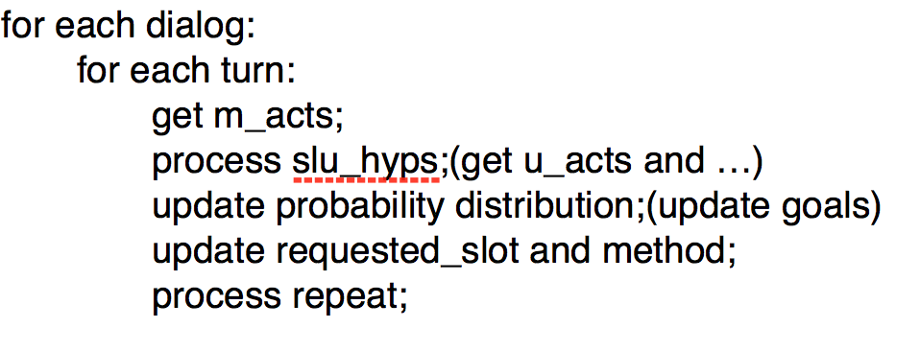
YARBUS
过程：

Slide 30
YARBUS
User action
Handbook.pdf-p19
System action
Handbook.pdf-p21

Slide 31
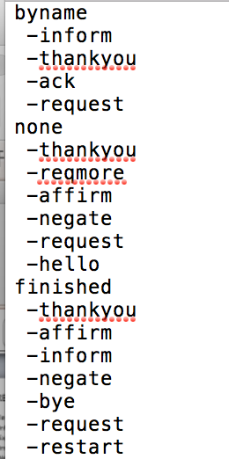
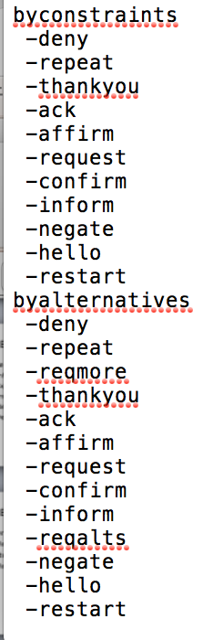
YARBUS
Method-action map
没有特定的对应关系

Slide 32
